Slide 1
State Workforce Development Board december 13, 2024

Slide 2
SWDB Membership
4 vacant “employer” seats to fill resignations - Al Harris, Colleen Hilton, Adria Horn, & Chris Mason
1 vacant “representative of the workforce” seat to fill resignation - Jen Fullmer
4 “employer” members up for re-appointment
4 “representative of the workforce” up for re-appointment

Slide 3
SWDB Legislation
SWDB staff reviewed current statute for the Board and submitted LR #142 – An Act Regarding the State Workforce Board for consideration by the 132nd Maine Legislature.
Three aspects of the proposed legislation:
Renaming the “State Workforce Board” to the “State Workforce Development Board” to align with WIOA.
Removes the requirement that members of the Board are subject to confirmation by the Maine Senate.
The legislation also would change to type of rulemaking regarding Industry Partnerships from “major substantive” to “routine technical”.

Slide 4
SWDB bylaws Ad Hoc committee
Motion
Move to establish an ad hoc committee for the purpose of reviewing the SWDB’s bylaws and making recommendations to the SWDB at its March 14, 2025, meeting.
SWDB Bylaws Ad Hoc Committee members
Chair Vaughan Woodruff
Luanne Ballesteros
Ryan Bushey
Jason Shedlock

Slide 5
Maine Workforce System Partner Presentation Commission on Disability Employment

Slide 6
CDE Mission & Purpose
Advise, consult and assist the executive and legislative branches of State Government on activities of State Government that affect the employment of disabled individuals. The standing committee is solely advisory in nature. The standing committee may advise regarding state and federal plans and proposed budgetary, legislative or policy actions affecting disabled individuals;
Serve as an advocate on behalf of disabled citizens promoting and assisting activities designed to further equal opportunity for people with disabilities;
Conduct educational programs considered necessary to promote public understanding of the employment-related needs and abilities of disabled citizens of this State;
Provide information, training and technical assistance to promote greater employer acceptance of disabled workers;
Advise and assist employers and other organizations interested in developing employment opportunities for disabled people; and
Work with state and local government officials, organizations representing persons with disabilities and the business community to inform the public of the benefits of making facilities and services accessible to and usable by individuals with disabilities.
http://www.mainelegislature.org/legis/statutes/26/title26sec2006.html
Notes:
Summary notes:
Statutorily required committee of the SWB, originally a “Governor’s Committee” but moved into MJC/SWB decades ago.
All volunteer; big ask in statute
Current function limited to:
Provides advisement to state gov’t, both exec and legislative branches
Provides/supports advocacy and education re: PWD and employment
Link to statute

Slide 7
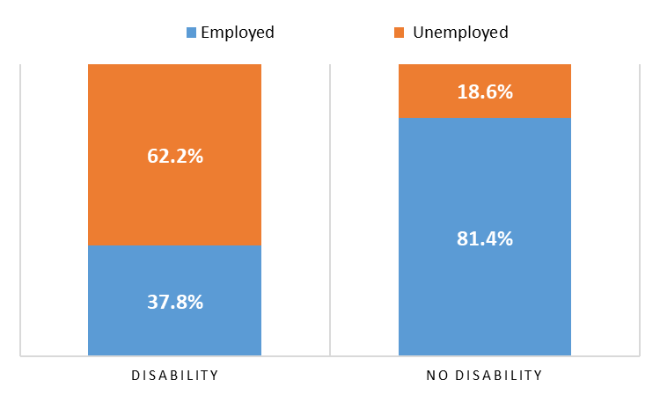
Maine People with Disabilities
How many people in Maine have a disability?
111,585 working age adults
13.5% of working age population
How many Mainers are (un)employed?
People with disabilities have the highest unemployment rate of any minority group
Sources: https://www.maine.gov/labor/cwri/disabilities/index.html, U.S. Census Bureau QuickFacts: United States
Notes:
from 2023 Annual Disability Statistics Compendium, based on 2021 Census Bureau American Community Survey data
ACS disability definition: self-identified as vision, hearing, cognitive, ambulatory, self-care, and/or independent living disability
https://disabilitycompendium.org/sites/default/files/user-uploads/v1-Accessible_2023_Annual_Disability_Statistics_Compendium_ALL_Final.pdf
111,585 working aged PWD in Maine
We have a higher than national average percentage, important to pay attention to this population that can be overlooked.
Contributing factors
- Aging workforce (Maine is the oldest state): 65+ is the largest growing segment in labor market
Increased prevalence of employees experiencing mental health challenges in the workplace: 25% increase in anxiety and depression since COVID
- Long COVID: a new disability layer
Aging Maine workforce – more disability prevalence
Retention is of critical importance in workforce shortage
Age-related accommodations are common
State Working-Age SSA disability recipients % of total working-age population Ranking
West Virginia 11.85% 1
Kentucky 10.37% 2
Mississippi 10.31% 3
Arkansas 10.18% 4
Alabama 9.81% 5
Maine 9.20% 6
Louisiana 8.90% 7
Michigan 7.99% 8
Rhode Island 7.82% 9
Missouri 7.81% 10

Slide 8
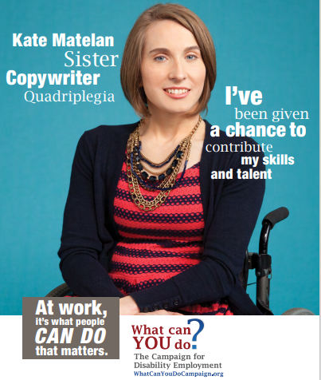
What is Disability?
The majority of disabilities are non-apparent
Definitions from ADA and WHO offer different perspectives
Anyone can experience disability at any point in time
Notes:
ASK: what do you think disability is?
TELL: 80% of disabilities are not apparent (ADD/ADHD, Anxiety/Depression, Post Traumatic Stress Disorder (PTSD), Autism, Learning Disability, Deaf/Hard of Hearing, etc.)
What is definition of disability:
Americans with Disabilities Act (ADA) Definition of Disability
The ADA defines a person with a disability as a person who has a physical or mental impairment that substantially limits one or more major life activity. This includes people who have a record of such an impairment, even if they do not currently have a disability.
World Health Organization Definition of Disability
A broad term that the World Health Organization describes as, “the interaction between individuals with a health condition (e.g., cerebral palsy, Down syndrome, and depression) and personal and environmental factors (e.g., negative attitudes, inaccessible transportation and public buildings, and limited social supports).”
Anyone can experience disability at any point in time
Illness and injury do not discriminate
Disability is part of normal lifespan
more than 46% of individuals 60 years and over have a disability
https://www.un.org/development/desa/disabilities/disability-and-ageing.html
Images from the What can YOU do campaign – four individuals of different backgrounds, disabilities, job titles,

Slide 9
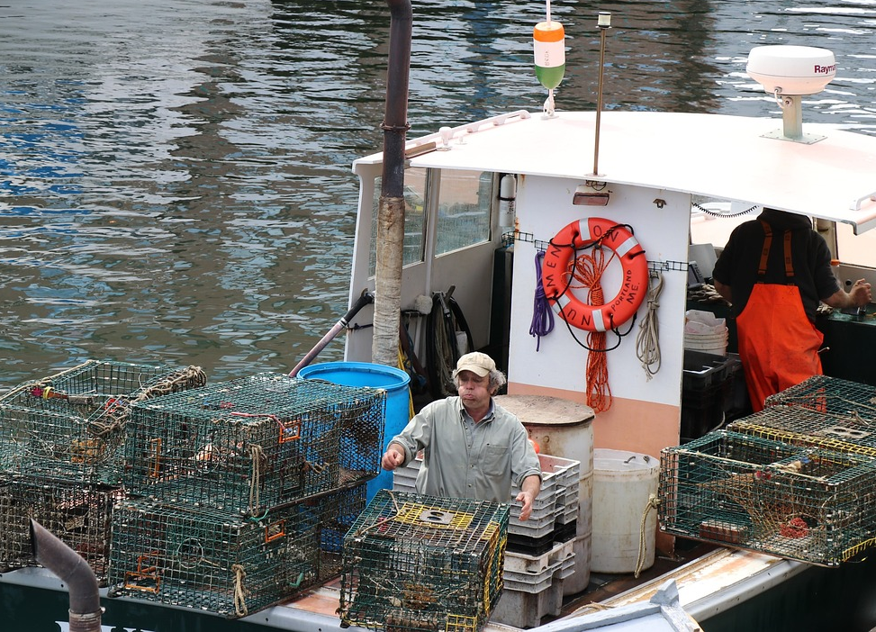
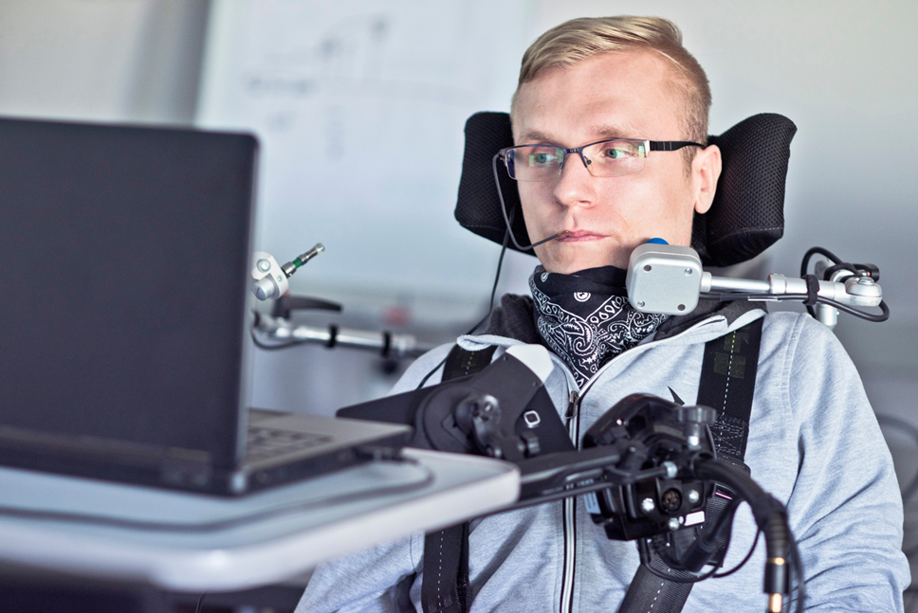
Where do people with disabilities work?
Notes:
People with disabilities work in every type of job…
Pictures of workers using accommodations in jobs that employers may not expect (include public safety role too) need broad representation

Slide 10
Maine People with Disabilities Work!
Machinist
Drywall and Ceiling Tile Installer
Medical Assistant
Engineering Technician
Nursing Assistant
Bus Driver
School Financial Manager
Chief Executive
Graphic Designer
Hairstylist
Lobsterperson
Advocate
Police Officer
Firefighter
Accountant
Town Manager
Dietician
Janitor
Interpreter / Translator
Computer Programmer
Childcare Worker
Registered Nurse
Clergy
Highway, Maintenance Worker
Clinical Psychologist
Community Health Worker
Human Resource Specialist
Information Security Analyst
CDL Truck Driver
Administrative Services Manager
Agricultural Technician
Electrician
Aircraft Mechanic / Service Technician
Office Clerk
Carpenter
Food Service Manager
Cashier
And many more!
Notes:
Actual people in Maine are working in these jobs. This is a sampling of job titles.

Slide 11
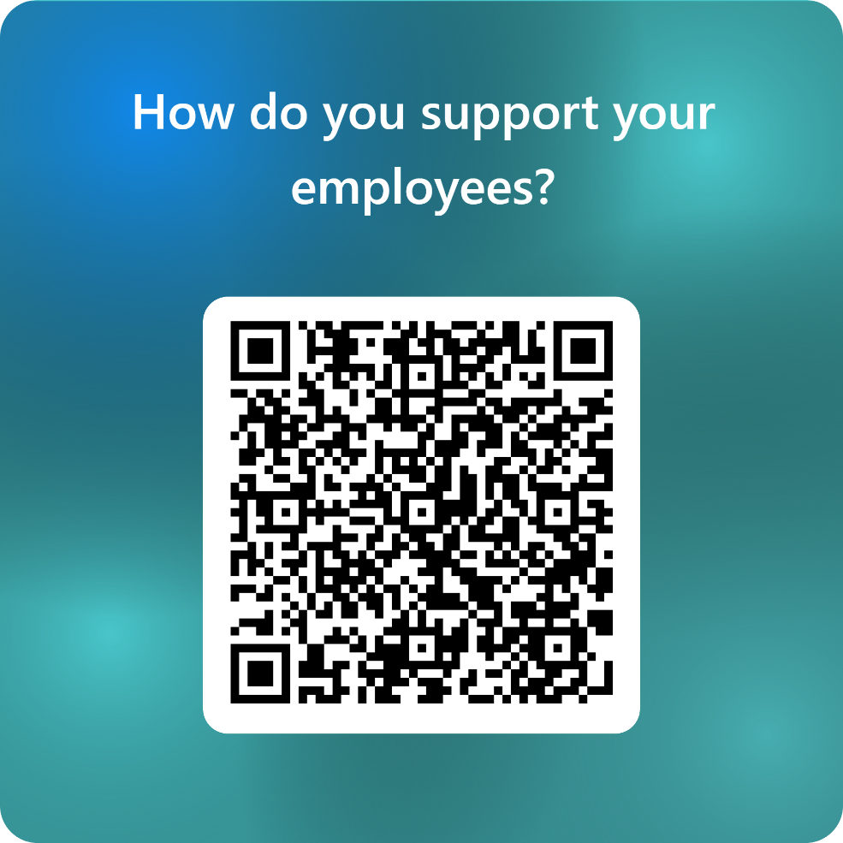
How do you support your employees?
Poll
More possibilities – with universal design in mind
Provide accessible/adaptable formats of materials and/or training strategies
Ensure software and websites are accessible for screen readers
Encourage transparency about how to ask for accommodations if needed
Consider physical accessibility to workspaces
Notes:
Poll & Discussion (mentimeter? Poll anywhere? Other options? Microsoft Forms? Need technical assistance)
Pre populated list with option for open text
Flexible scheduling/job sharing
Remote Work
EAP/mental health support
Live transcripts / recordings of meetings
Administrative support
Technology tools
COVID facilitated need for adjustments to retain valuable staff (not necessarily pwd) – 2022 Kessler Foundation report findings regarding general employer practices to support employees, normalizing supporting pwd as employees
Workplace supports / potential reasonable accommodation examples
Flexible work schedules / job sharing (esp during workforce shortage)
Shifting job duties or tasks.
Provide reserved parking.
Improve accessibility in a physical work space or digitally through technology.
Change the presentation of tests and training materials.
Provide or adjust a product, equipment, or software.
Provide an aid or a service to increase access.

Slide 12
Your current employees
You already employ people with disabilities – just may not know
And you may already be making accommodations without realizing it
Examples: flexible scheduling, remote work, ergonomics & safety
How does/can your org culture support the employment of PWD
Foster a culture where people feel safe and respected. Take an ATP approach
Consider establishing an Employee Resource Groups (ERG) related to disability and leadership to support development of inclusive culture
If in a management position, understand how to recognize a request for accommodations, avoid making assumptions, interactive process.
Utilize accessible technology resources to ensure your documents, presentations, and interviews are inclusive.
Provide opportunities for professional growth.
Facilitate inclusion in work-related events and social activities.
Notes:
Foster a culture where people feel safe and respected, take an Ask the Person approach:
1. Ask someone “How” rather than assuming they can’t do something.
2. If someone is utilizing an interpreter or a job coach, speak directly to the person, not their interpreter / job coach
If in a management position:
Understand how to recognize a request for accommodations, avoid making assumptions (about what someone needs or can/can’t do)
Ensure identification of accommodations is an “interactive” process (engage the person in the discussion about possible accommodations)
between the employee and the employer. The employee often knows what accommodation(s) will work best, because they know the barriers presented by their disability. The employer has information and access to the systems, policies, and practices in place within the organization. Both pieces are necessary for a successful accommodation process.
Utilize accessible technology resources to make your documents, presentations, and interviews more inclusive. (captioning, sans serif fonts of appropriate size, image descriptions).
Microsoft suite has fantastic accessibility features.
Office Accessibility Center - Resources for people with disabilities (microsoft.com)
Provide opportunities for growth
People with disabilities do not have to be stay in position they were hired – they are trainable too!
Be inclusive with social activities at/away from the workplace.
75% of job loss is due to lack of inclusion in workplace culture

Slide 13
Workforce Shortage = Opportunity
General rule – retention and reliability of people with disabilities is higher
Employment rates for PwD now exceed pre-pandemic levels by 3.6%, while nondisabled are below by 0.5%
Employers increasingly flexible due to staff vacancies and new work structure options
Notes:
PWD did not participate in “the great resignation” and PWD employment “at an all-time high level”
AskEarn.org resources (maybe for fact sheet too)

Slide 14
Inclusive recruiting, hiring, and onboarding
Avoid creating/perpetuating barriers
Ensure accessibility of process & materials
Include accommodations statement on application
Avoid requiring degrees for jobs if not truly needed
Expand recruitment sources, mechanisms
Be flexible about interpreting gaps in work history
Simplify and streamline application and onboarding process
Provide training and support to hiring team related to disability inclusion and accommodation strategies in recruitment
Notes:
Accessibility of application process – screen reader friendly, accommodations statement and how to access accommodations in the application process
Requiring degrees for jobs that don’t necessarily need a degree (hsd janitor)
Accepting job applications only from one source (only online, sending printed resumes by mail, etc.)
Discounting anyone with gaps in work history
Taking extensive amount of time from application to onboarding process (people need $, need to start)

Slide 15
What if reasonable accommodations are needed?
Cost
93% one time cost $300 or less (half were no cost)
Benefits
Direct: retention, productivity, attendance
Indirect: co-worker interactions, safety, morale
Resources
Job Accommodation Network (www.askjan.org)
New England ADA Center (www.newenglandada.org)
Notes:
Visible vs. invisible disabilities … which often result in very different kinds and degrees of stigma and call for different calculations of disclosure (plain language)
Lifelong vs. later in life disabilities … which can affect the amount of social integration a person has had, the quality of their education, and their overall comfort and experience with their own disabilities. IE: someone who has never had sight, vs someone who has degenerative sight.
Physical, sensory, intellectual, learning, and mental health disabilities, and chronic pain and chronic illness … each of which have different practical effects and call for different types of accessibility and accommodation. Many will not need accommodations to perform the job but possible accommodations to apply and learn.

Slide 16
Success Story
Notes:
Presenter shares their own stories, varies by presentation
Close with PSA by clicking on image – hyperlink to this video: whatcanyoudocampaign.org/wp-content/uploads/2017/08/psa-i-can-audio-introduced-60s.mp4

Slide 17
Paid Family & Medical Leave Presentation

